Slide 1
Weekly meeting
2 22 2024
Ty Bottorff

Slide 2
Outline
New colitis dataset
their main findings
cell type abundance analysis
TCR feature analyses
ATACseq practice: mean coverage plots

Slide 3
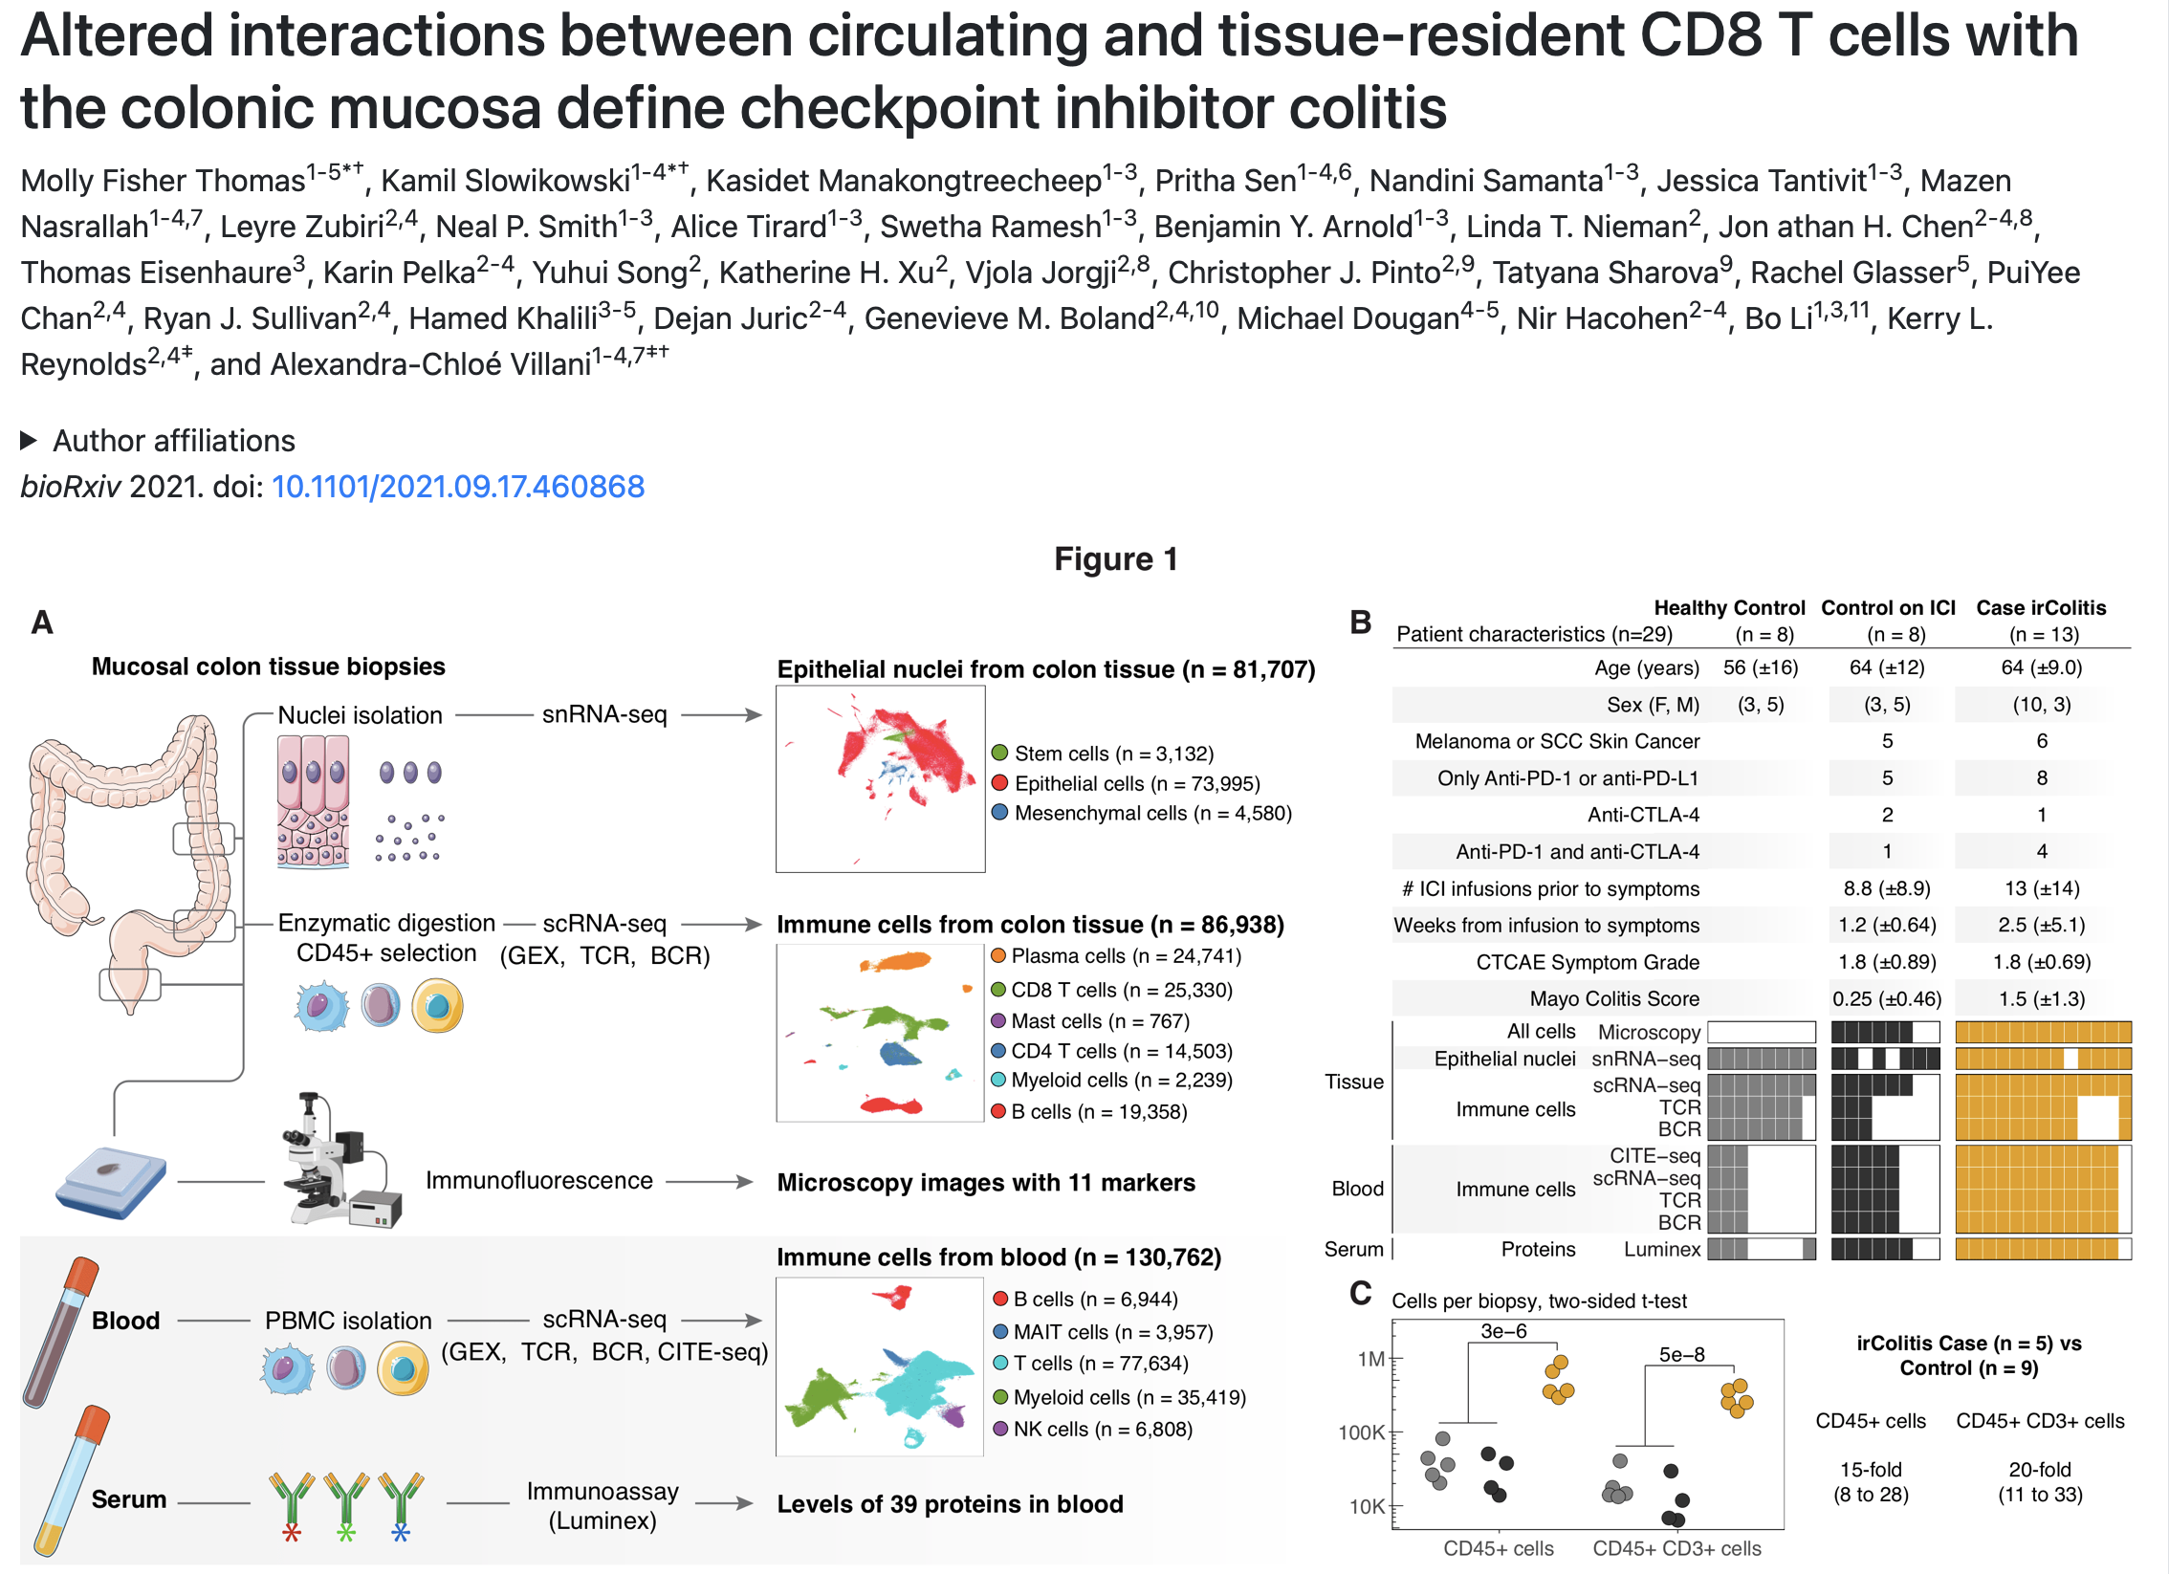
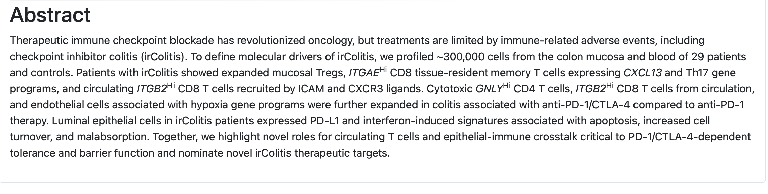
New colitis dataset
Notes:
biopsies for this study were taken from the descending colon, sigmoid, and rectum and analyzed together
most patients on ICI therapy had melanoma or lung cancer, were treated with PD-1 blockade (either as monotherapy or in combination with anti- CTLA-4), and were biopsied within two weeks of symptom onset
of the 8 control patients on ICI therapy, 4 had ICI-related gastritis and/or enteritis with sparing of the colon
used canonical genes to group immune cells into broad cell types including B cells (MS4A1, JCHAIN), T cells (CD3D, CD8A, CD4), and myeloid cells (LYZ)
HC and ICI no colitis aggregated together for all remaining analyses (didn’t see big differences between them)

Slide 4
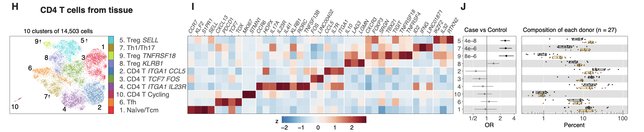
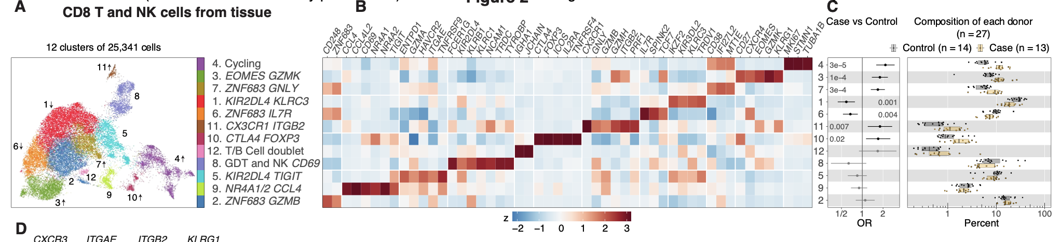
New colitis dataset (their analysis): cytotoxic CD8 T cells and CD4 Tregs are more abundant in colitis tissue
Notes:
HC and ICI no colitis aggregated together for all remaining analyses (didn’t see big differences between them)

Slide 5
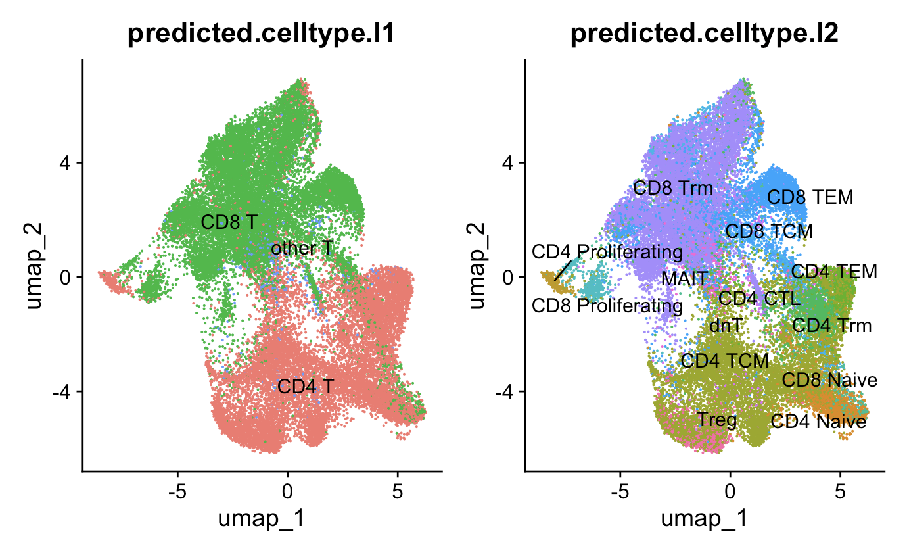
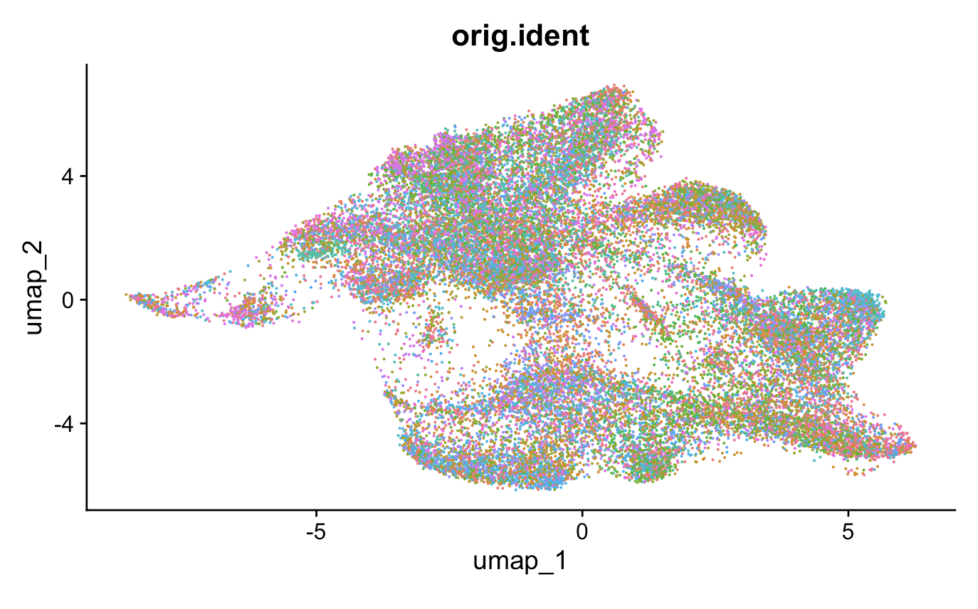
New colitis dataset: don’t see evidence of batch effects, cell typed with Seurat (Trms manually w/ markers)

Slide 6
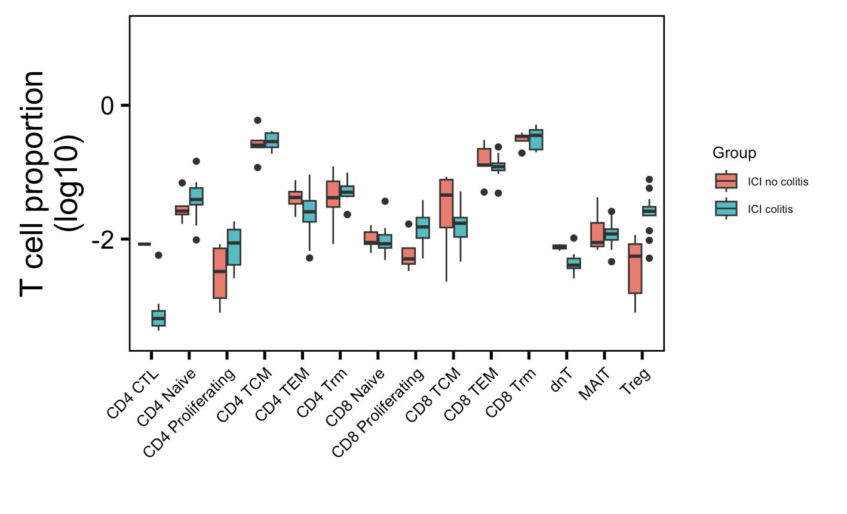
New colitis dataset: although proliferating T cells trend up in colitis group, only Treg abundance statistically different between irAE groups (they also saw Tregs up)
*
Wilcoxon rank sum test. *, padj < 0.05

Slide 7
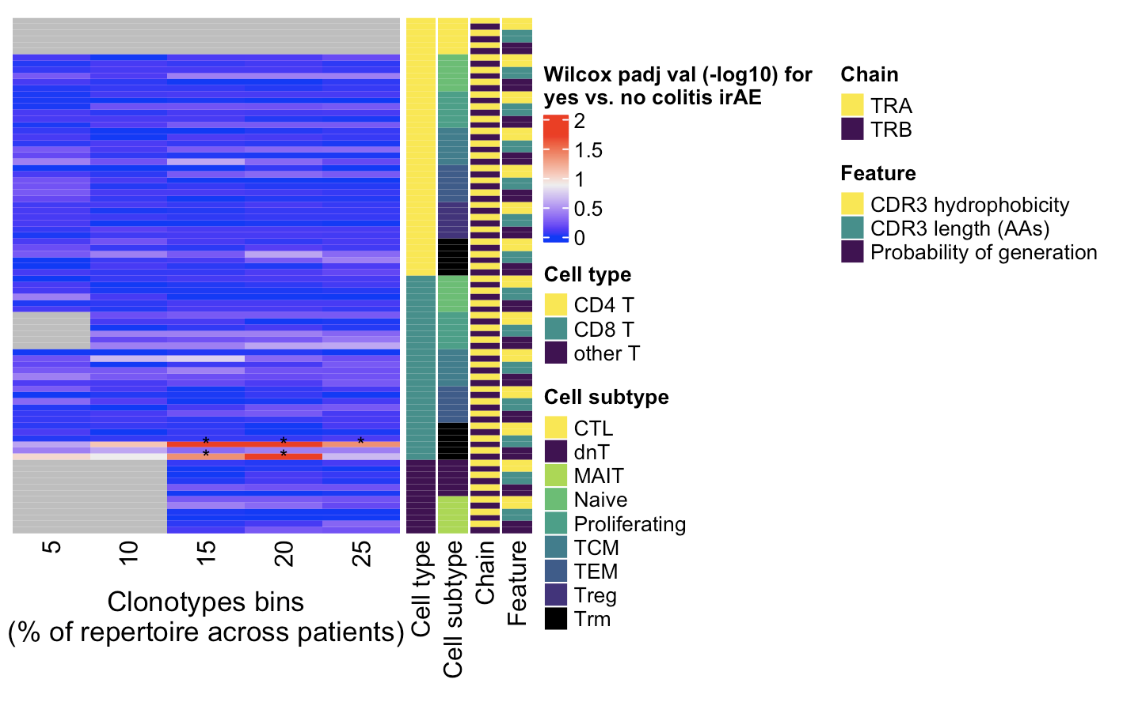
New colitis dataset: CD8 Trm TRB (not TRA like in old colitis dataset) have different pgen scores (and CDR3 lengths) by irAE group
*
Wilcoxon rank sum test. *, padj < 0.05

Slide 8
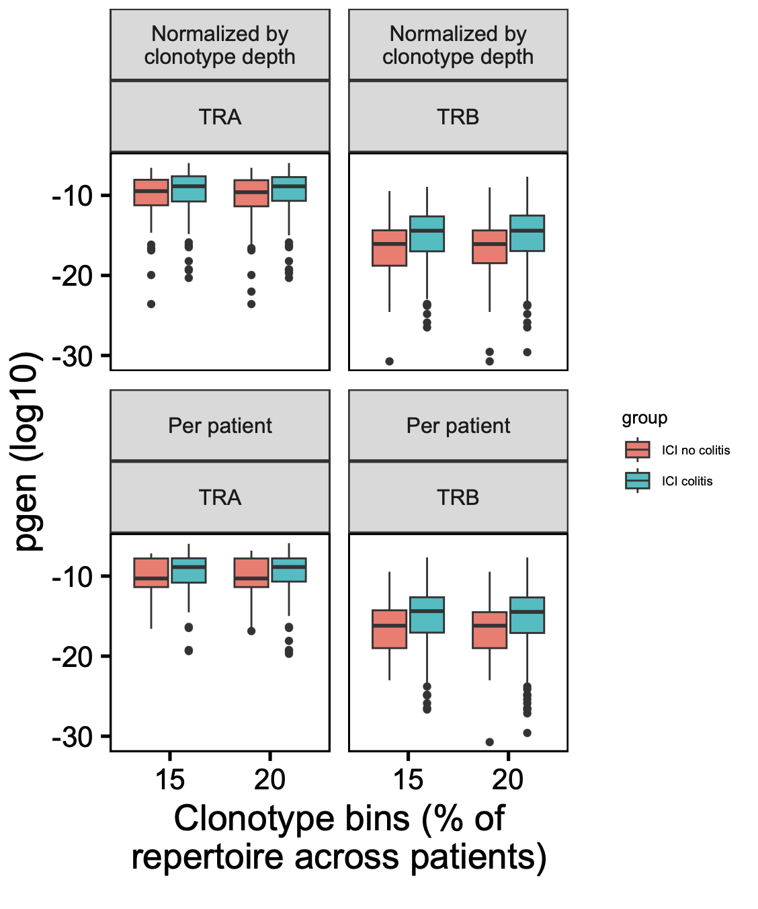
New colitis dataset: CD8 Trm TRB pgen higher in colitis group (not TRA like in old colitis dataset)
*
*
→
More germline-like
Less germline-like
→
Wilcoxon rank sum test. *, padj < 0.05

Slide 9
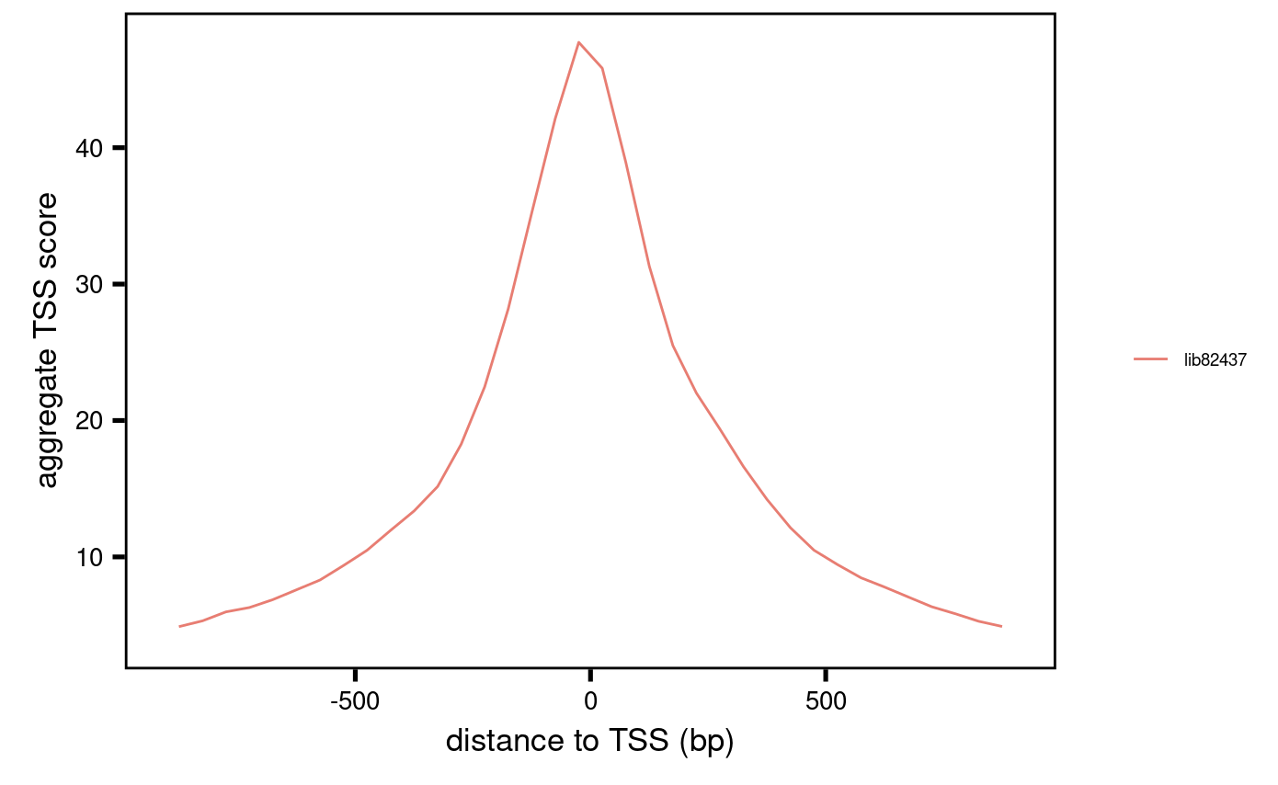
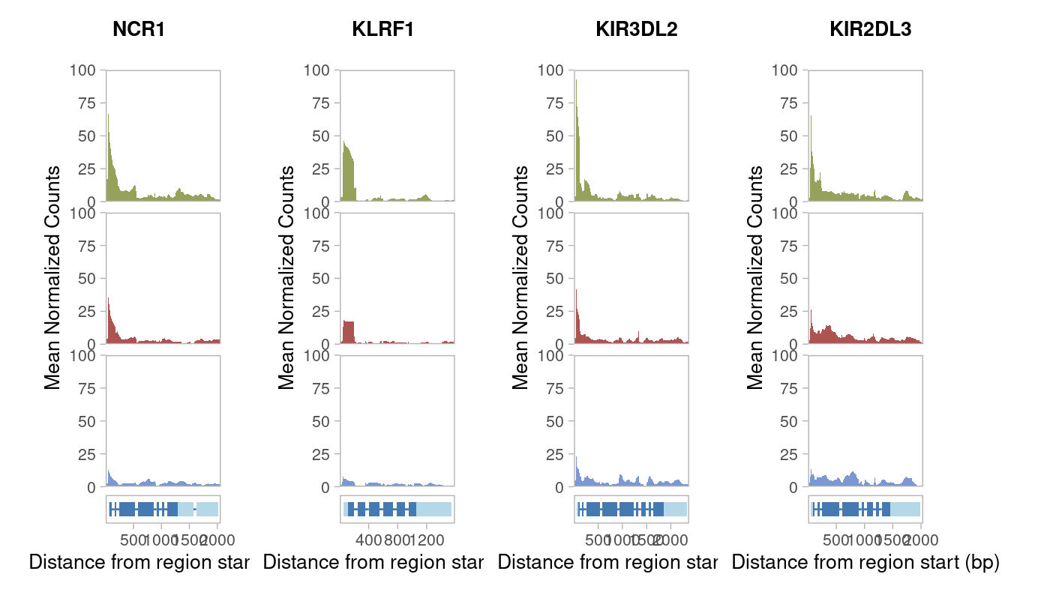
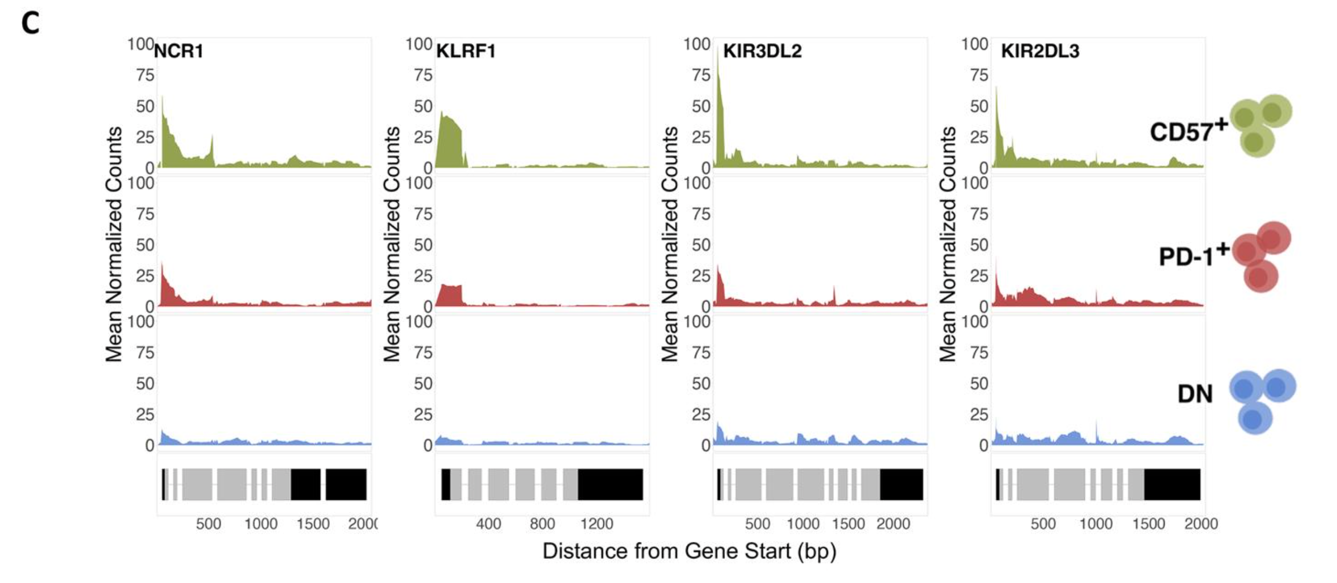
ATACseq: TSS enrichment (QC) & mean coverage plots
Erin’s
Ty’s
Notes:
fragments from the NFR are expected to be enriched around the transcription start site (TSS) of genes

Slide 10
Conclusions
Data not shown: no differences in convergence frequencies between irAE groups by chain, cell type even among highly expanded (top 10%) T cells (old colitis dataset)
New colitis dataset doesn’t seem to recapitulate old’s results one very well
Don’t see CD4 proliferating T cells up in colitis tissue (as seen in old colitis dataset)
Highly expanded CD8 Trm TRB pgen higher in colitis group (unlike CD8 Trm TRA pgen higher in old colitis dataset colitis group)
Data not shown: at all (unique) TCR level (per chain/group), do observe differences between irAE groups for…
CD8 Trm CDR3 length and pgen
CD4 Trm CDR3 length
CD8 proliferating pgen
don’t see CD4 proliferating pgen difference as seen in old colitis dataset

Slide 11
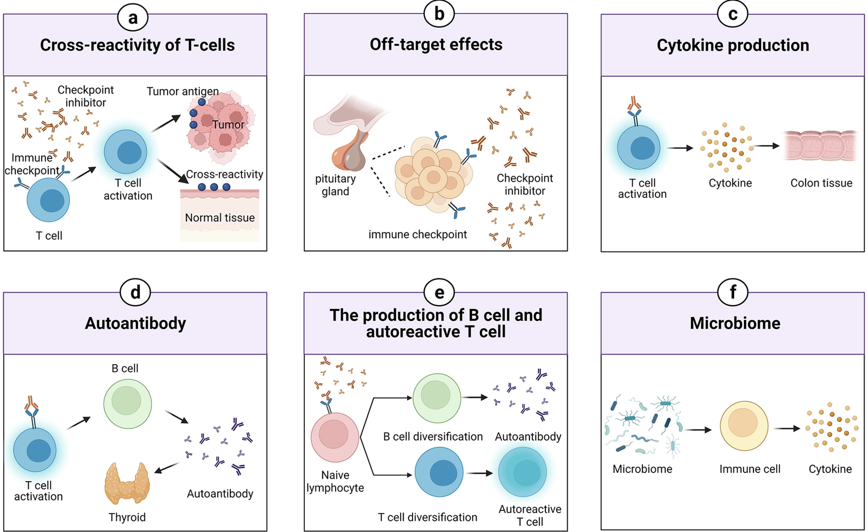
Next steps
Could look at cytokine
genes, not as novel
New colitis dataset: analyze PBMCs as well, B cells too?
Combine colitis datasets?
Cell typing: get unicell deconvolve working and compare to other methods/references
Consider new irAE hypotheses to test, new biological questions entirely?
Could look at B cell data
in new colitis dataset,
Probably less B cell data available than T

Slide 12
Cell typing metrics (old colitis dataset)
51,396 cells & 4 methods/reference datasets used to map cell types
0% of cells have same label across all
~17% have same label across 3/4
~52% have same label across 2/4
~31% have different labels from all
Caveat: different methods/references have different names (like CD4 Th1, Th2, Th17 vs. CD4 TEM/TCM) that I can’t standardize?
Notes:
# 51396 cells
# all 4 methods agree: 0
# 3/4 methods agree: 8612
# 2/4 methods agree: 26750
# all 4 methods different: 16034

Slide 13
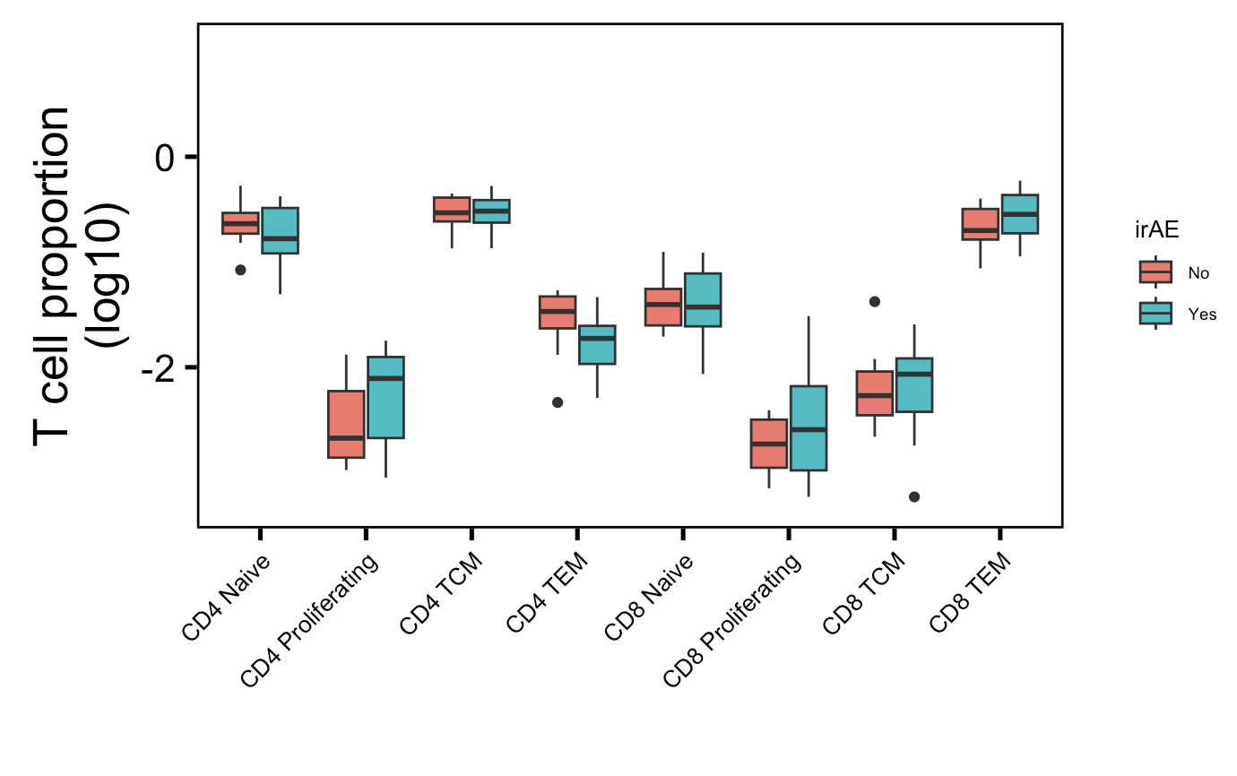
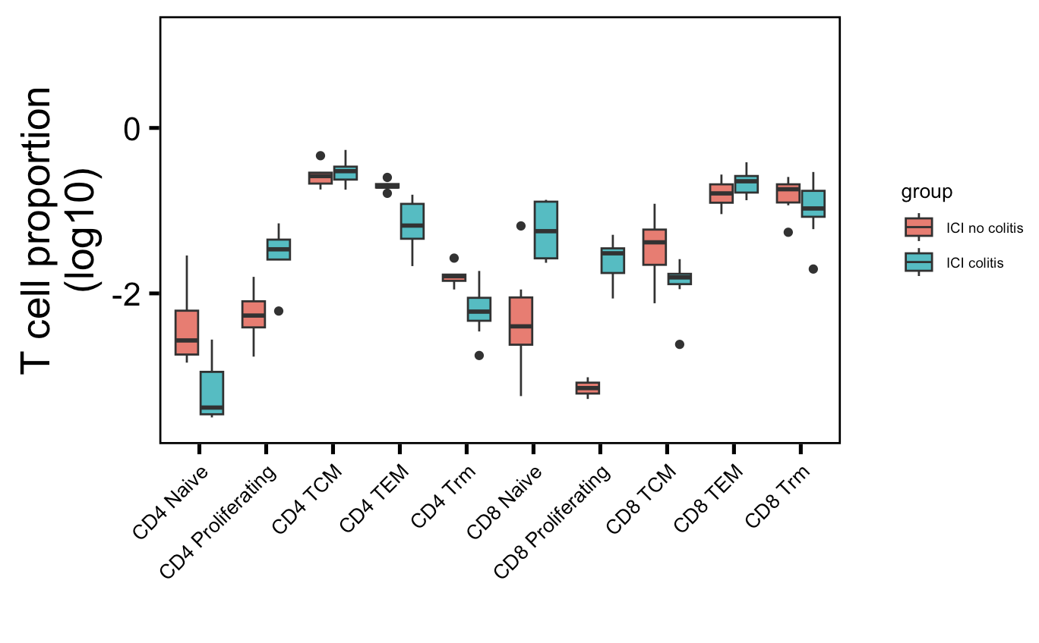
Other datasets cell abundance analyses
→
: up in their analysis
→
: down in their analysis
PBMC myocarditis-focused dataset (mostly PD-1 blockade)
Colon tissue colitis dataset (CTLA-4/combo blockade)
→
→
→
→
**
Wilcoxon rank sum test. **, padj < 1e-2

